Slide 1
A new client for Beyond All Reason
Redesigning the redesign for fun and profit

Slide 2
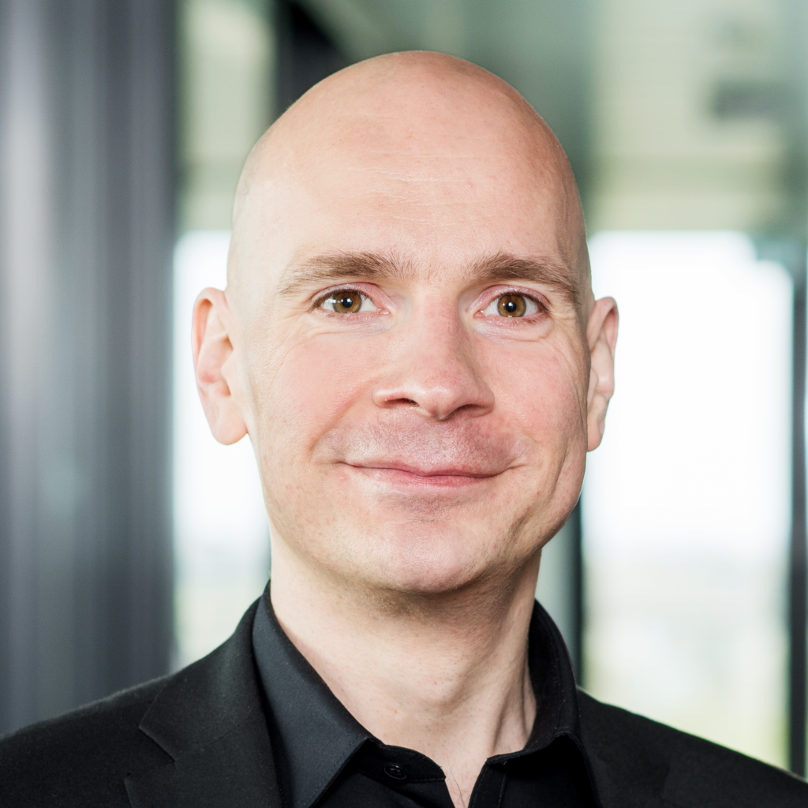
Who is this guy even?
I am 45 years old.
After my studies in Computer Science, I worked as a professional software engineer for 10 years in product companies and consulting companies. 8 years ago, I switched to business analysis, requirements engineering and UX.
My RTS experience started with Dune 2000, Warcraft 1 and Command & Conquer. I learned about BAR in 2020 while playing FAF.
Having only played SupCom but never TA, I have a strong outsider‘s view when it comes to the game and its mechanics.

Slide 3
What am I doing here?
When I heard that a new client was planned but the development (at least from a UI perspective) currently on hold, I wanted to see whether I might be of help.
Having had a look at the redesign ideas, I decided that it might be worthwhile to take a step back and try a different approach. On top, this is a really fun excercise.
When talking about „design“ here, it is always interaction design as opposed to visual design. The visuals of the redesign look absolutely bonkers and I couldn‘t ever come up with something half as awesome-looking.

Slide 4
Management summary
I am currently redesigning the client from scratch on the basis of analysis and discussions with people from the community
The discussions uncovered several problems resulting from how Chobby currently works, like the 8v8 meta.
Another topic with vastly varying opinions is the question, how prominent player‘s ranks should be displayed.
Some direction decisions have to be made while I am trying to figure out how to tackle the issues with clever interaction design.

Slide 5
My redesign is based on the question „What do players want or need in any given situation?“. It follows a set of core design principles
Use case driven design
all functionality should have a clear use case that defines its raison d'être.
Clear priorities for functionality
The most used functionalities and 90%-cases should be accessible as easily and quickly as possible.
We have a clearly visible prioritisation scheme on the UI that makes it easy to understand which parts are the focus of the game.
Clear priorities for the design
We favour simplicity and clarity over customisability. We avoid settings that ask players to effectively make design decisions for us unnecessarily. → more Apple, less Microsoft
Matchmaking-centric approach
We switch from a lobby-centric approach to matchmaking as much as possible with the goal of having explicit lobbies make up for up to 20% of PvP matches at most.
BAR is a game and not a desktop application
While ease of use and efficiency are key, we don't forget that this is a game and should feel like a game. Therefore, we give enough room to elements that aren't exactly needed for the functionality to work but support immersion.
Tailored solutions rather than one-size-fits-all approaches
We provide UI elements that are tailored to their respective use case rather than generic "one size fits all" solutions.
Parties of players as first-class citizens
We promote playing with friends and making them within the community by providing a solid party system.
We make parties a first-class citizen by giving it a dedicated space on the main screen and supporting matchmaking with parties. The UI properly reacts to a party being formed by removing Single Player items and replacing them with party-specific ones.
Be welcoming to new players
We strive for making the first steps for new players as easy as possible by guiding them through their first steps and making the UI elements as obvious and self-explanatory as possible.

Slide 6
We want to tackle the 8v8 meta problem by introducing matchmaking. There are some tricky bits to solve, though.
Each available mode will split up the number of players currently in queue. Most other RTS-es have a much easier time as they are almost purely 1v1. To combat the problem of player fragmentation, we considered multi-queueing. However, as this would lead to the smaller modes (1v1, 2v2) cannibalising the bigger ones (4v4, 8v8), this is not recommended.
Further recommendations are
Have rotating map pools for all the matchmaking modes
Still provide the possibility for a custom lobby with all settings available
Show queue information (number of players in queue, estimated wait time) to give players an idea of what to expect
Keep functionalities like unit and building stats available while queueing

Slide 7
One question was whether we want/need unranked modes as well. Also players have different opinions on how prominently to display open skill values.
Each player can either be playing at their best or slightly worse (by reason of trying new things or just being drunk). As in ranked play, everyone expects all their team members to do the former, there should be a room for those doing the latter, so having an unranked matchmaking seems reasonable. However, introducing unranked matchmaking will effectively double the number of queues, further segregating the player base.
Recommendation: Still implement unranked matchmaking modes as well. If we have too many different modes, some of them will just be empty all the time and can subsequently be removed.
While some players draw a lot of motivation from the entire „climbing the ranks“ idea and like seeing their OS value, others would rather the value not being displayed at all and only used for matchmaking behind the scenes as it is a source of ladder anxiety.
Recommendation: While there are very good arguments for both sides, showing the value is needed for certain types of player considerations (e.g. what to expect from team mates in a team game). Giving the possibility to completely hide the values for oneself should be provided, though.

Slide 8
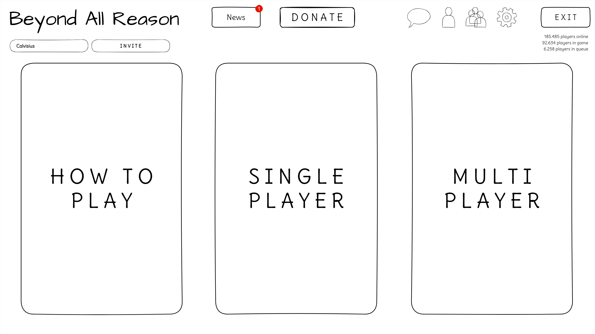
Design showcase I
This is the initial screen shown when starting BAR. It has a limited number of elements and a clear visual prioritisation through the sizes of elements.
The big panels are supposed to change on hover to their detailed views (see next slide).
Forming a party is now a first class citizen and party management always directly accessible.
Having three additional small areas below the three main panels could be considered for promotional stuff. Having an unread indicator on the news button could be sufficient as well.

Slide 9
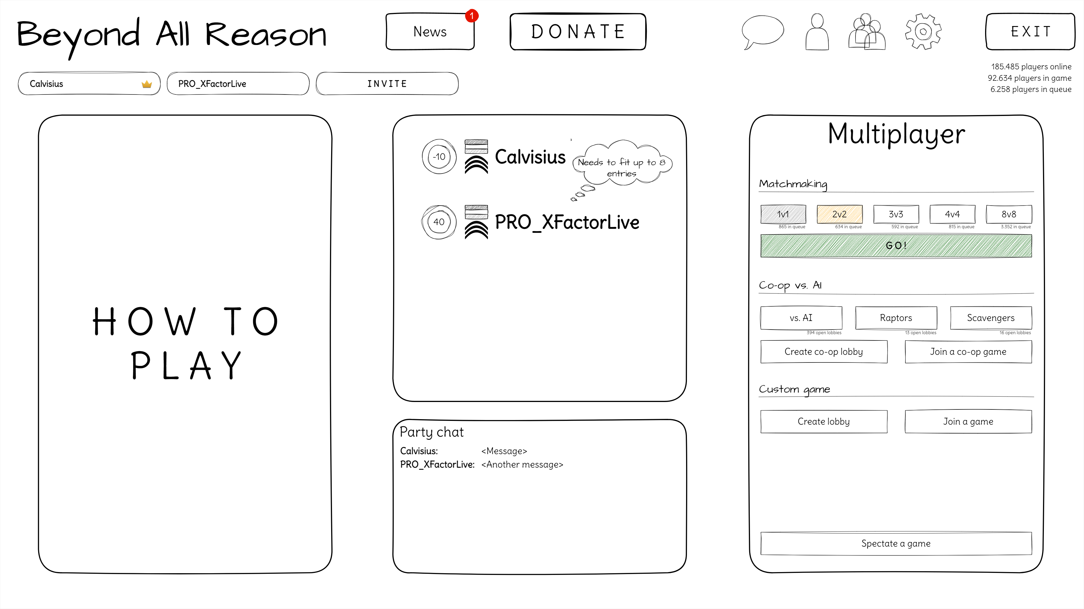
Design showcase II
Here, the multiplayer section detail is shown as seen by the party leader (when hovering over the panel).
As we now have a party of 2, the single player panel is not needed any more and replaced with a player detail view and a chat panel.
This design does not yet contain unranked, but it would look exactly as ranked.
For the „Co-op vs. AI“ and „Custom game“ sections, we can create or join a lobby.
„Spectate a game“ opens a browser with all running games to join as a spectator.
The party members see a read-only version of the multiplayer panel with only the information relevant for them.

Slide 10
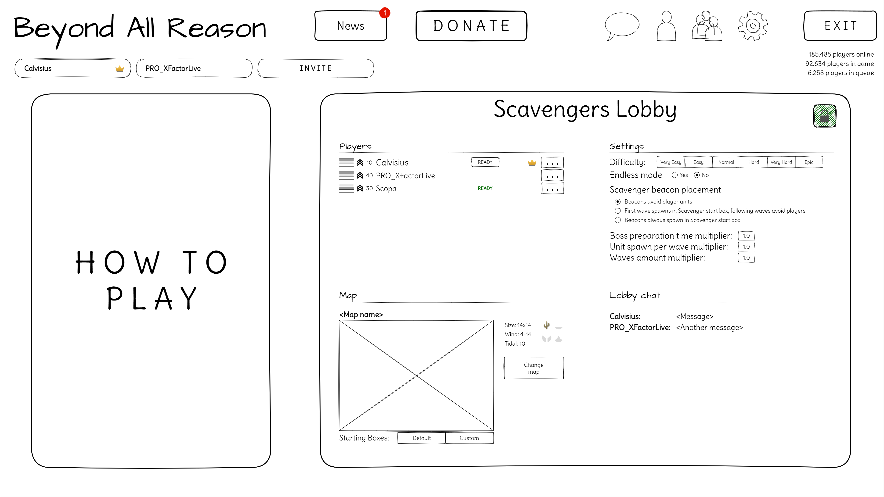
Design showcase III
When a lobby is created, it covers both the multiplayer and the single player areas.
For each play mode, there will be a dedicated lobby with only the options needed for that mode.
In this case, it allows for placing all of the options for the mode directly in the lobby where they can be adjusted by the lobby boss, but also seen by everyone else.
The map display now shows additional information about the map directly in the lobby. Changing the start boxes has been moved to a separate popup screen.
The ready status is now given more room.
I might have forgotten the „Start“ button here. Just imagine it being left of the lock icon.

Slide 11
And that‘s all for now!
I am looking forward to your feedback regarding the ideas and designs I have presented here.
I am also happy to discuss everything and will continue discussing topics I stumble across with the community members to gather insights.
There certainly will be more times when decisions will be needed like the topics outlined earlier. It would be nice to have some kind of contact to directly ask questions.
All the documentation and the designs are residing in the „bar-lobby“ git repository (as soon as my pull request has been merged).
To check out and/or edit, download Obsidian and open the vault in the „obsidian“ folder of the repository.
This presentation has already been stored there as well.

